Slide 1
Introduction to html
ENGL 307 March 28th, 2012

Slide 2
What is HTML?
Hyper Text Markup Language

Slide 3
What is this sorcery?
HTML is made up of elements
These elements indicate structure
Structure and content are two separate monsters
The tools used to build pages can be no frills and are usually built right into the computer

Slide 4
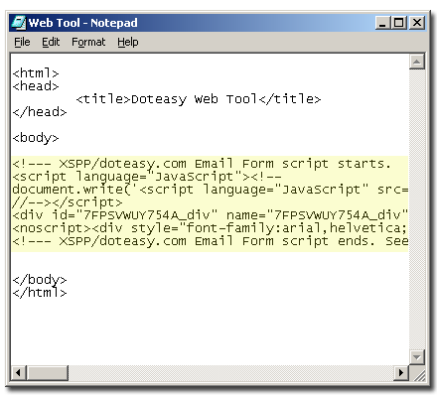
Tools
Notepad (Windows)
TextEdit (Mac)
TextWrangler (Mac)
jEdit (Windows and Mac)
Notepad++ (Windows)

Slide 5
Why HTML is Awesome
It uses plain text
It works on all computers
It describes what documents mean
It’s easy to learn the basics
It’s free
(Harris, 2011)

Slide 6
Meet the Tags
Tags are what separate elements from one another
Start with a < and end with />
Basic foundational tags:
<html> </html>
<head> </head>
<title> </title>
<body> </body>

Slide 7
Building a Page

Slide 8
Adding Text
Starting a new paragraph
<p> </p>
Paragraph alignment
<p align=“center”> </p>
Line breaks
<br> </br>
Headings
<h1> </h1> and so on

Slide 9
Formatting Text
<strong> is for text that has strong importance
<b> is for text that should be presented in bold but doesn’t have greater importance (i.e. keywords)
<em> is for words that have emphatic stress
<i> is for text that should be in italics but has no extra emphasis

Slide 10
Assignments for Next Class
Readings and tweets (posted to course site)
Make a basic page in HTML and screenshot it. Post it to your blog with a write up of the process. Be ready to discuss these in groups next class.

