Slide 1
Final Lesson: CSS and Inline Styles
#dw307
April 11, 2013

Slide 2
Think of a web page…
. . . as a series of boxes.

Slide 3
The <div> Tag
Block level element
Acts like a paragraph
Used to group elements
Can be formatted with CSS

Slide 4
CSS?
Cascading Style Sheets
HTML is a way to do content, and CSS is adding styles
Style: rules on how to format particular portions of a page
Style sheet=set of styles
Separate language from HTML, but works with HTML to make it pretty

Slide 5
p {
color: red;
font-size:20px;
}

Slide 6
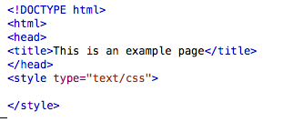
How Do I Add This Stuff?
Make an Internal Style Sheet
Goes after the <head>
Write <style type=“text/css”>
Go down a couple of spaces and write
</style

Slide 7
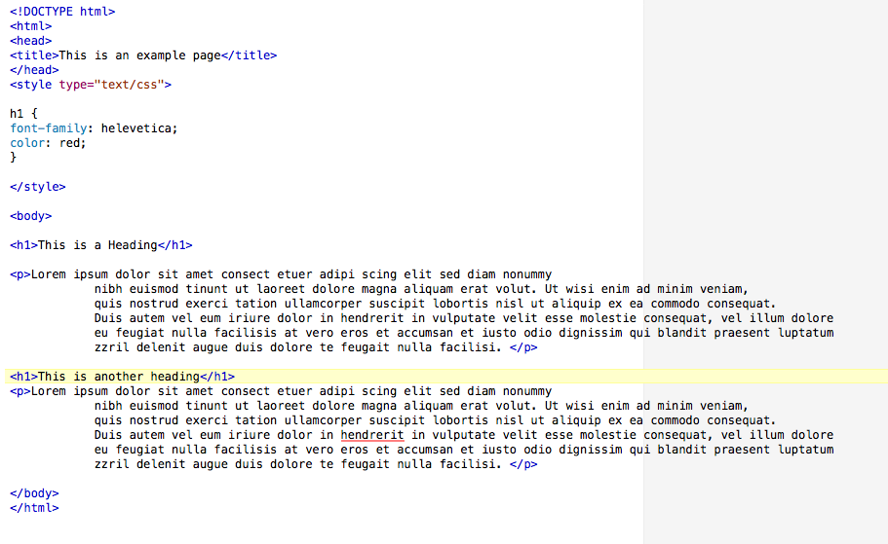
Using Selectors

Slide 8
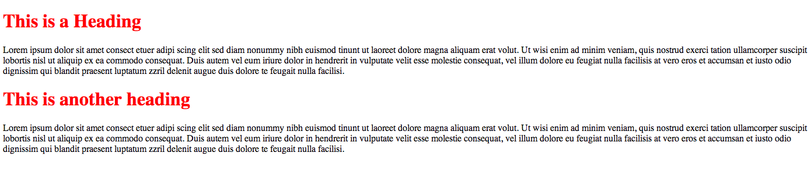

Slide 9
Back to the <div> Tag
<div> tags go in the HTML portion of the page
CSS is used to position and style them
Name the containers you want the content to go in and give them an id
  Container
  Navigation
  Header
  Content
  Footer

Slide 10
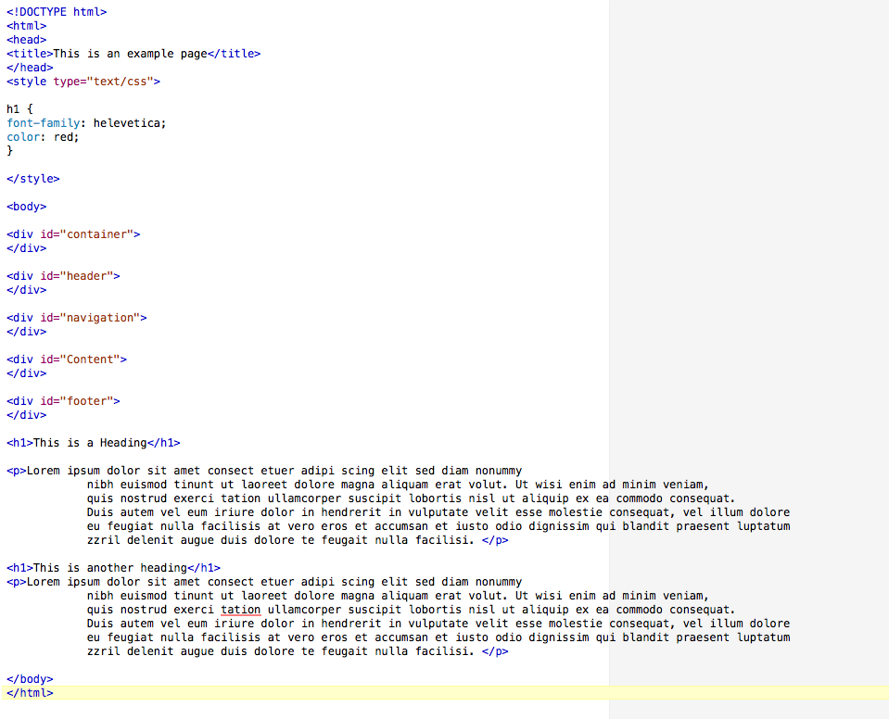
Notes:
Don’t Worry about the content yet, we’ll put it in the right place in a second. For now, you make the <div> ids in the html portion

Slide 11
Now that the places are marked in the html…
… add the CSS at the top.

Slide 12
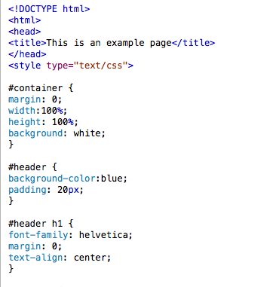
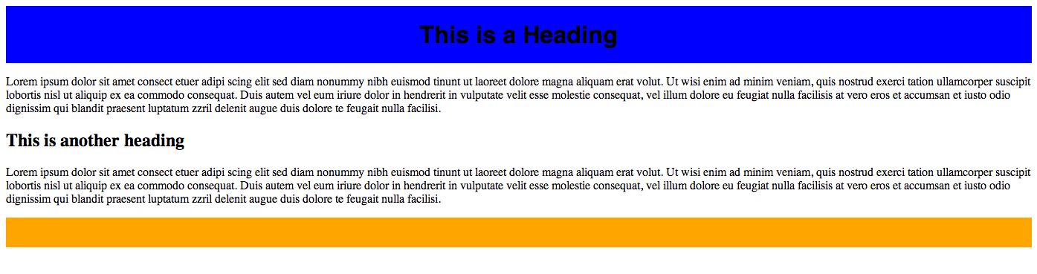
Notes:
The # sign indicates that it should refer to the section. It is called an “id selector.” In more advanced CSS, there are also classes, which are marked by a period. We’re not going to worry about that. Explain the margins, padding, and the width/height.

Slide 13
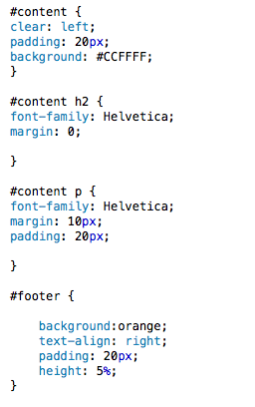
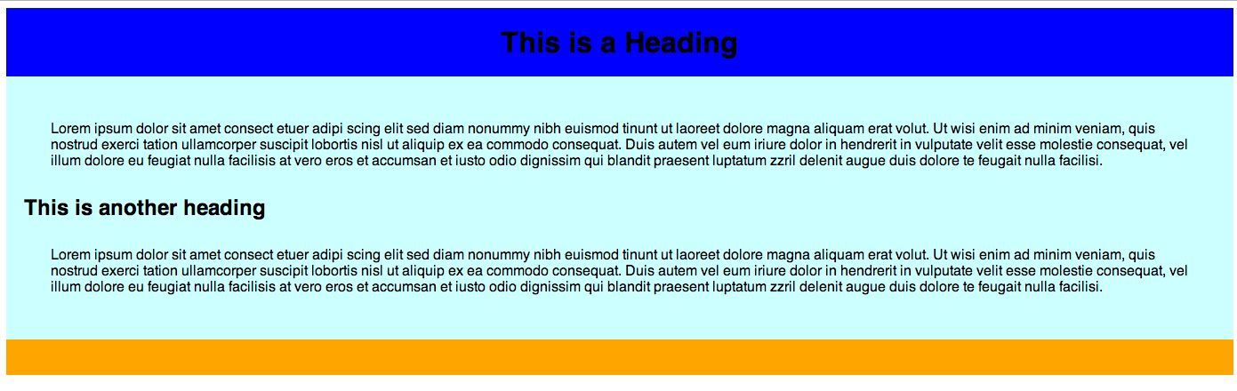

Slide 14
Making the Header an Image
Rules are different from html:
background-image: url("images/clouds.gif");
Use this when you want the image to appear on all pages of the site.

Slide 15

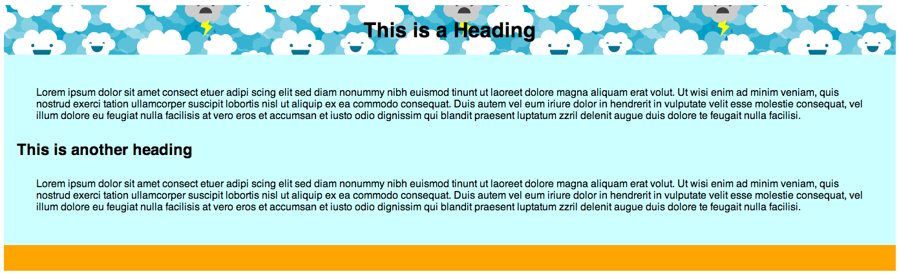
Notes:
Want to make it lighter? Go in GIMP and lighten the image, then save it as a .jpg, .gif, or. png and use the file! Inserting an image is the same as always if you want to add it in the content. However, need to explain the /images route.

Slide 16
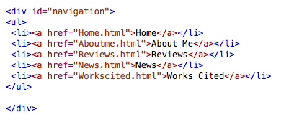
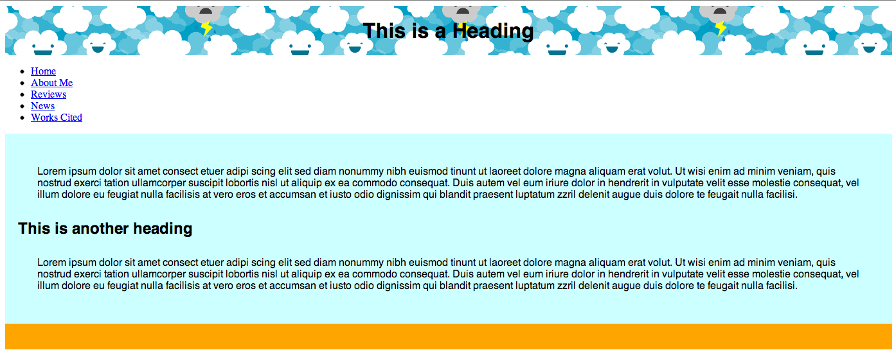
Making a Navigation Bar
Is a list in html, with links
Notes:
UL=UNORDERED LIST
LI=LIST ITEM

Slide 17
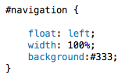
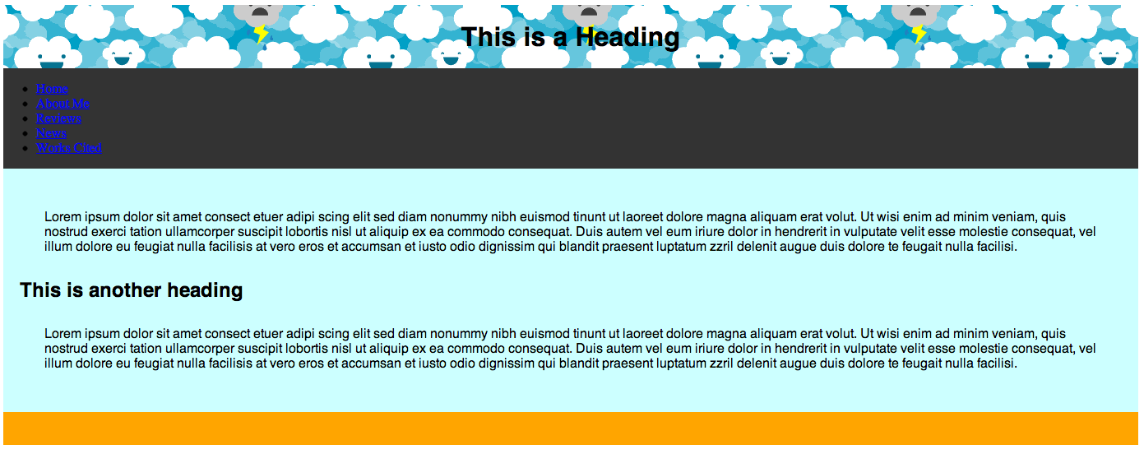
Notes:
Gonna have to explain the float. Float means: positioning property.

Slide 18
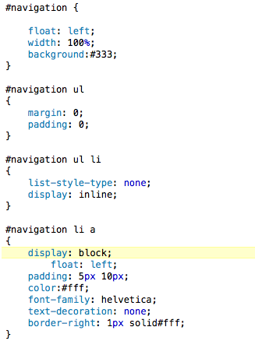
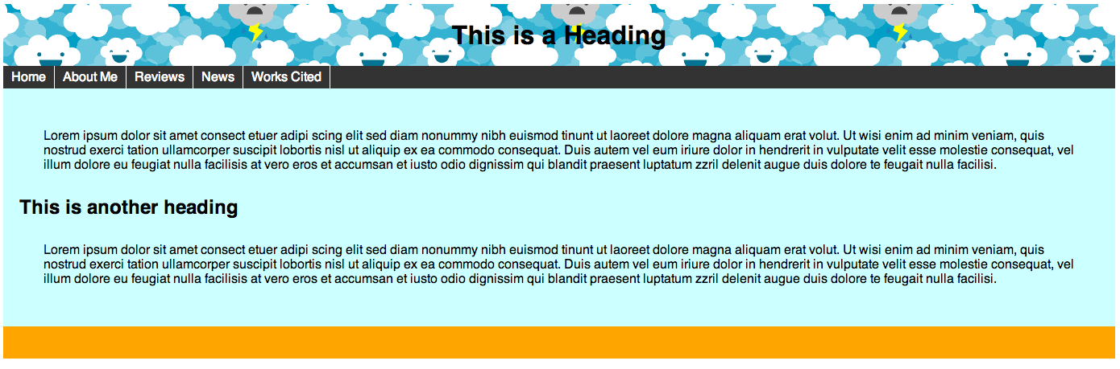
Notes:
This is CASCADING. Whole bar is #navigation, the ul is applied to the ul element, ul li is applied to both, (list0style-type) makes them not bullets, and display inline makes it horizontal, and the li a makes it applicable to each dealie in there.

Slide 19
Building a site

Slide 20
Next Class
Meeting in Adobe Connect
Will do a peer review
Tweets will not be readings, but any helpful videos/links you find

